Slide 1
INTRODUCTION TO WAVEGUIDES
EEEN 566– MICROWAVE ENGINEERING
Friday, 06 February 2026

Slide 2
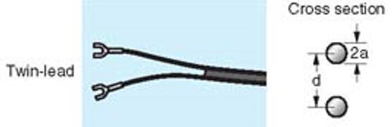

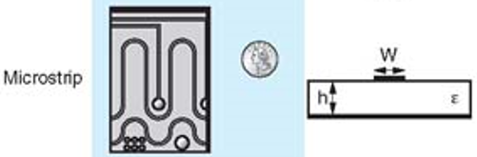
A PAIR OF CONDUCTORS IS USED TO GUIDE TEM WAVE
Two-wire TL
Coaxial cable
Microstrip

Slide 3
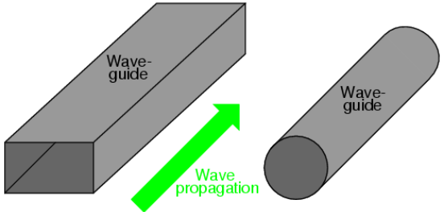
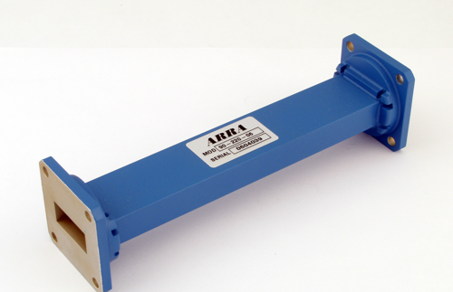
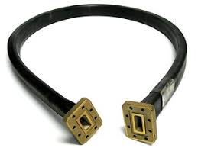
WHAT IS A WAVEGUIDE?
A waveguide is an electromagnetic feed line used in microwave communications, satellite earth stations and radar installations.
A waveguide consists of a rectangular or cylindrical metal tube or pipe. It can also be flexible.
The electromagnetic field propagates lengthwise.
They are often used with horn or dish antennas.
Notes:
A waveguide is a physical structure used to direct electromagnetic waves from one place to another. This specialized technology forms the backbone of many communication and radar systems, enabling the transmission and manipulation of signals at microwave frequencies.

Slide 4
WHAT IS A WAVEGUIDE? (2)
A waveguide is a structure that guides waves, such as electromagnetic waves, light or sound waves. They enable a signal to propagate with minimal loss of energy by restricting expansion to one dimension or two.
Without the physical constraint of a waveguide, signals will typically be radiated and decreased according to the inverse square law as they expand into three-dimensional space.

Slide 5
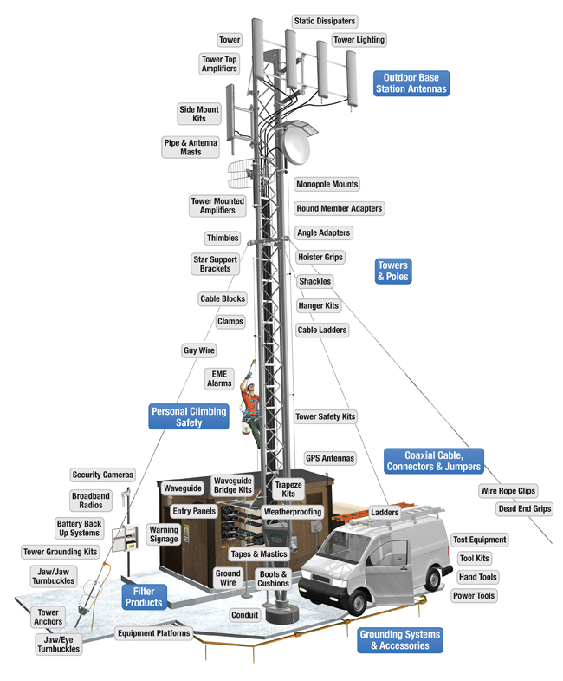
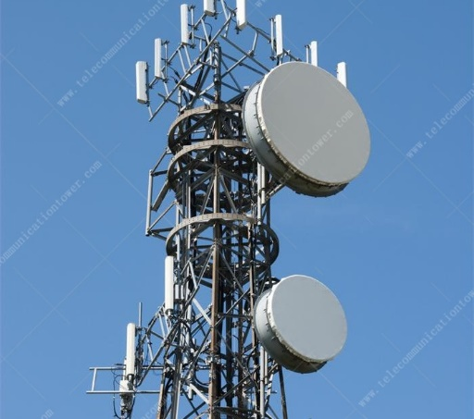
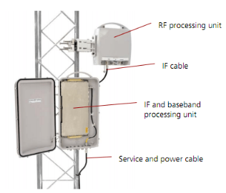
GSM BTS antennas operating in 900 and 1800 MHz band
Parabolic antenna for microwave link to Base Station Controller (4 – 6 GHz)
(a) Sometimes the dishes are covered to avoid dust and water collection
(b) For tall towers, the RF and baseband processing units are sometimes mounted high up on the tower.

Slide 6
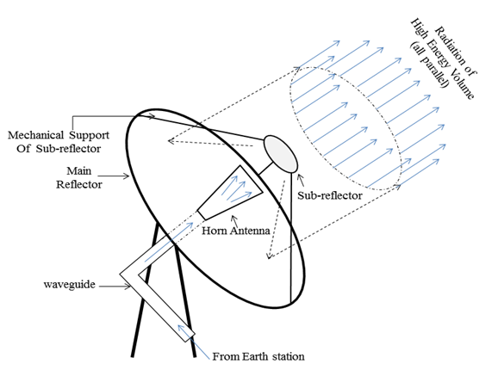
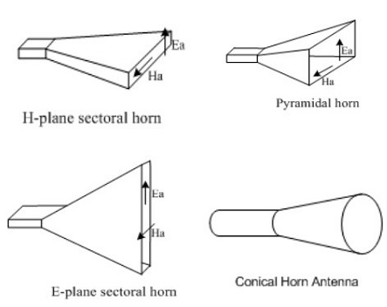
HORN ANTENNAS USE WAVEGUIDES
A Horn antenna is usually a flared-out waveguide, by which the directivity is increased and the diffraction is reduced.

Slide 7
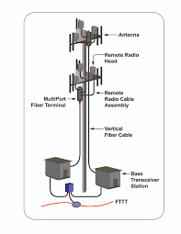
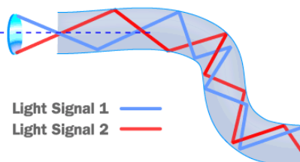
BASE STATION WITH FIBER INSTEAD OF METAL WAVEGUIDE
(a) Fiber Optic Cable is waveguide that guide in two dimensions and can effectively be used as flexible pipes for light.
Coax Loss Calculator | KV5R.COM
Fiber Loss Calculator (samm.com)

Slide 8
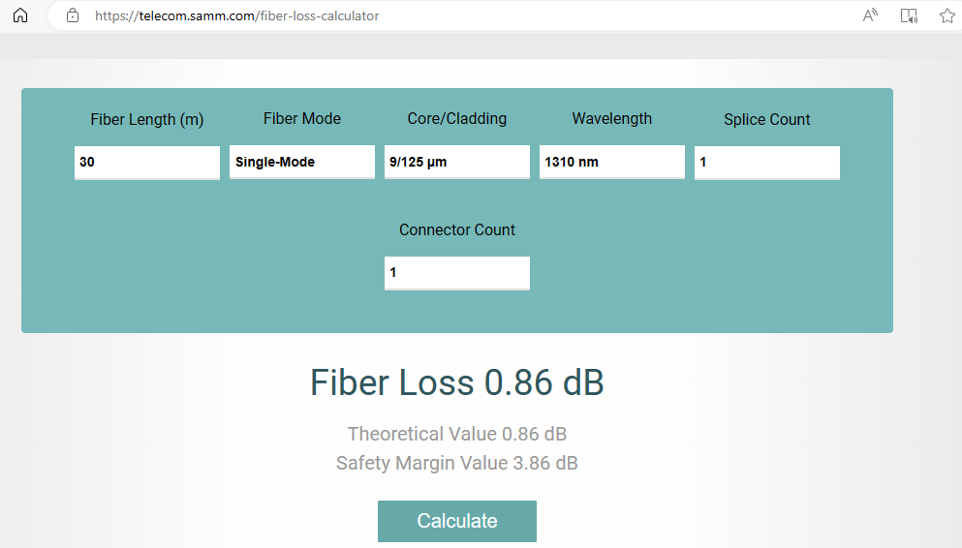
USE THIS ONLINE CALCULATOR TO GET FIBER LOSS FOR 5m, 10m, 30m
Go to the website shown below and verify that fibre cable loss is negligible for typical telecommunication tower heights.
Fiber Loss Calculator (samm.com) - https://telecom.samm.com/fiber-loss-calculator

Slide 9
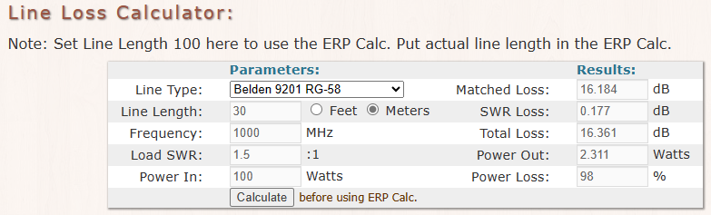
USE THIS ONLINE CALCULATOR TO GET CABLE LOSS FOR 5m, 10m, 30m
Go to the website provided below and verify that at microwave frequency ranges 1GHz, 10GHz, 20 GHz, … the cable losses are very high and unacceptable for long distance applications.
Coax Loss Calculator | KV5R.COM
https://kv5r.com/ham-radio/coax-loss-calculator/

Slide 10
WHAT IS A WAVEGUIDE IN MICROWAVE ENGINEERING?
A waveguide is an electromagnetic feed line used in microwave communications, broadcasting, and radar installations.
A waveguide consists of a rectangular or cylindrical metal tube or pipe.
Electromagnetic field propagates lengthwise in waveguides
Waveguides are most often used with horn and dish antennas and in Radar systems.
Waveguides do not support TEM mode.
Waveguides are unable to support wave propagation below a certain frequency, termed the cutoff frequency. They therefore act as high pass filters.

Slide 11
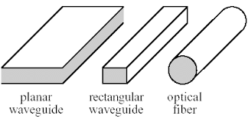
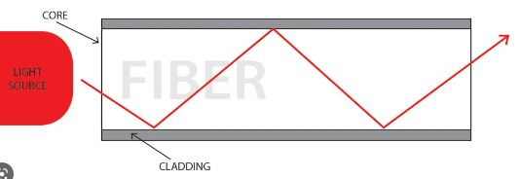
TYPES OF WAVEGUIDES
Four types of waveguides are:
  Rectangular Waveguide is for high-power microwave applications but is limited in frequency range and tends to suffer from dispersion.
  Circular waveguide has higher power handling capability than the rectangular one.
  Planar waveguide has a smaller loss than metallic waveguide at high frequency.
  Optical fibre has wider bandwidth and provides good signal isolation between adjacent fibers.
Notes:
Types of waveguides
Rectangular Waveguides: This is the most common type of waveguide, often used in radar technology. It features a hollow, rectangular tube structure, allowing it to handle a wide range of frequencies.
Circular Waveguides: As the name suggests, these waveguides have a circular cross-section. They are typically used in systems requiring rotational symmetry, such as circularly polarized antennas.
Dielectric Waveguides: These waveguides consist of a dielectric material — an insulator that can be polarized by an applied electric field. They are commonly used in integrated optics and optical fibers.

Slide 12
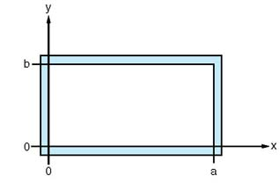
RECTANGULAR WAVEGUIDE FUNDAMENTALS
Propagation is in the +z direction.
The interior dimensions are “a x b”, the longer side is “a”.
Higher modes have higher attenuation and be difficult to extract from the guide.
In practice, “b” is chosen to be about “a/2”
If “b” is increased beyond “a/2”, the next mode will be excited at a lower frequency, thus decreasing the useful frequency range.
Brass, copper or aluminum conducting wall electroplated with silver or gold on the inside and smoothly polished to reduce loss.
“b” affects attenuation; smaller “b” has higher attenuation.
“a” determines the frequency range of the dominant, or lowest order mode.

Slide 13
RECTANGULAR WAVEGUIDE FUNDAMENTALS
Waveguides support Transverse Electric (TE) and Transverse Magnetic (TM) modes.
The order of the mode refers to the field configuration in the guide and is given by “m” and “n” integer subscripts, as TE_{mn} and TM_{mn}.
The “m” subscript corresponds to the number of half-wave variations of the field in the x direction.
The “n” subscript is the number of half-wave variations in the y direction.
“m” and “n” determines the cutoff frequency for a particular mode.
Cutoff frequency, f_{c} of a waveguide is the lowest frequency at which a wave can propagate through it

Slide 14
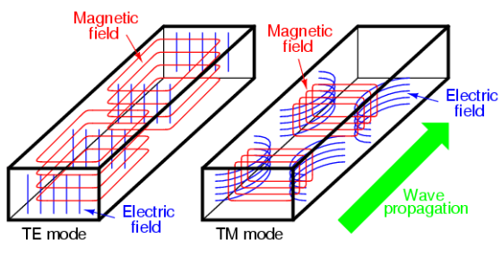
WAVEGUIDE MODES /01
Electromagnetic waves traveling through a waveguide follow different patterns, known as modes.
There are two principal modes:
  Transverse Electric (TE) where the electric field is entirely transverse, i.e., perpendicular to the direction of propagation. There is no electric field component in the direction of propagation.
  Transverse Magnetic (TM) where magnetic field is entirely transverse, and there is no magnetic field component in the direction of propagation.

Slide 15
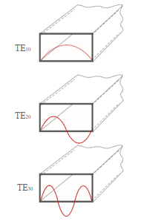


WAVEGUIDE MODES /02
Waveguides can support multiple modes with each mode having a different minimum cutoff frequency below which the wave does not pass through the waveguide.
The modes are designated as TE_{mn} or TM_{mn}.
The numerical subscripts m and n denote the number of half-wave variations in the electric field across the waveguide's cross-section along the x and y directions respectively.
TE₀₁
TE₀₂
TE₀₃

Slide 16
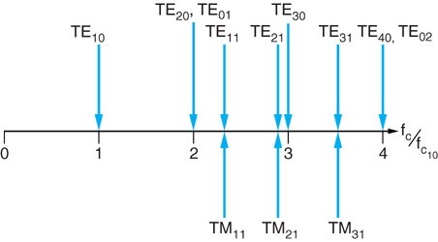
THE RELATIVE CUTOFF FREQ FOR THE FIRST 10 MODES WITH a = 2b

Slide 17
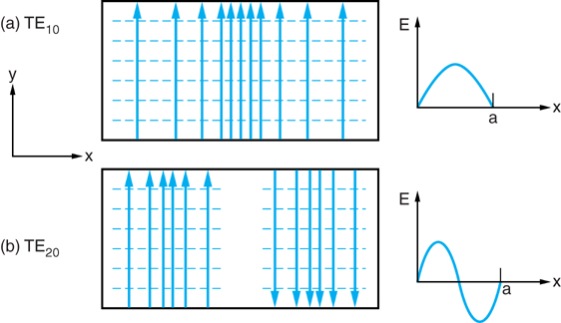
TRANSVERSE ELECTRIC (TE) MODES IN RECTANGULAR WAVEGUIDE

Slide 18
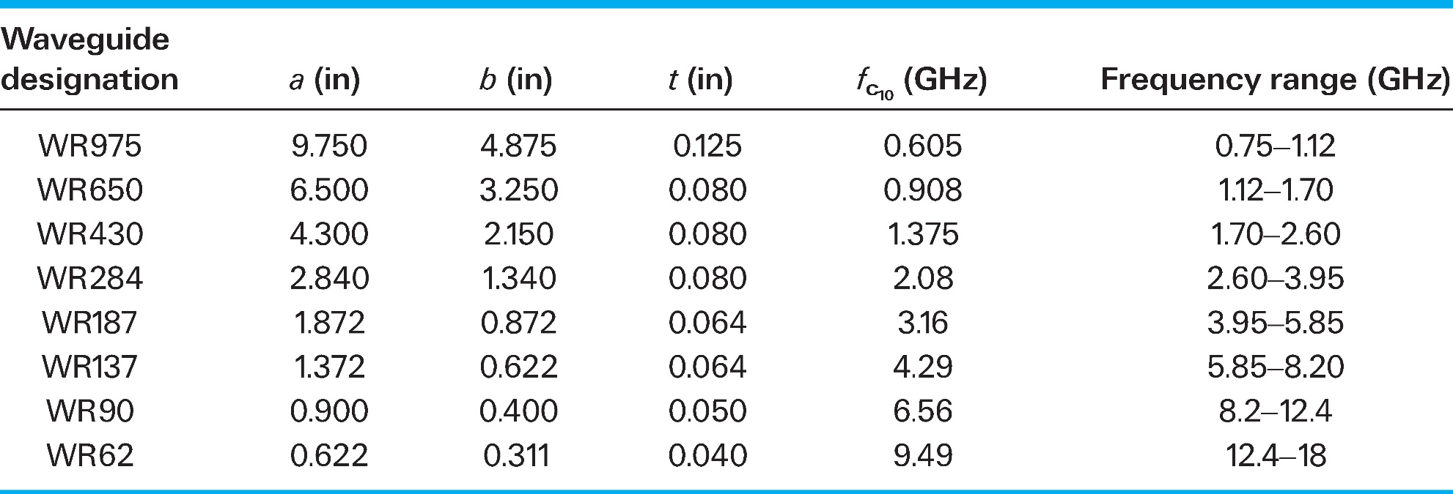
STANDARD WAVEGUIDE SIZES
Further Reading:
Waveguide Sizes | Dimensions & Cutoff Frequency - everything RF

Slide 19
SUMMARY: APPLICATIONS OF WAVEGUIDES
Waveguides are used as transmission lines in applications where it is necessary to carry high power at microwave frequencies (transmitters and microwave ovens) or where it is necessary to carry signals for long distances (fibre optic communication).
The following are examples of applications of waveguides.
  Radar transmitters for civilian and military applications
  Satellite earth station transmitters
  NMR machines in medicine
  Particle accelerators
  Industrial and domestic microwave ovens.

