Slide 1
MICROWAVE DEVICES
ECE 524E – MICROWAVE ENGINEERING
Friday, 27 February 2026

Slide 2
RECAP-WHAT ARE MICROWAVES?
Microwaves have frequencies in the range 300 MHz to 300GHz
Stray reactances become more significant as frequency increases
Transmission line techniques must be applied to short conductors like circuit board traces
Device capacitance and transit time are important
Cable losses increase with frequency and as a result waveguides instead of transmission lines.

Slide 3
RECAP-WAVEGUIDES
Pipe through which waves propagate
Can have various cross sections
  Rectangular
  Circular
  Elliptical
Can be rigid or flexible
Waveguides have very low losses compared with transmission lines.

Slide 4
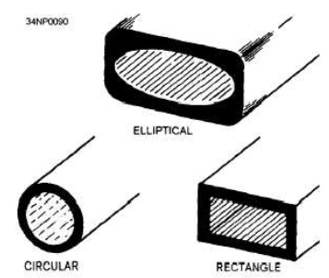
ADVANTAGES OF WAVEGUIDES(1)
There are 3 advantages of using waveguides, i.e
1. Copper Losses: Two-wire transmission lines have large copper losses because they have a relatively small surface area. The surface area of the outer conductor of a coaxial cable is large, but the surface area of the inner conductor is relatively small. At microwave frequencies, the current-carrying area of the inner conductor is restricted to a very small layer at the surface of the conductor by an action called ‘Skin Effect.’

Slide 5
ADVANTAGES OF WAVEGUIDES(2)
2. Dielectric Losses are lower in waveguides than in two-wire and coaxial transmission lines because it is air filled.
Dielectric losses in two-wire and coaxial lines are caused by the heating of the insulation between the conductors.

Slide 6
ADVANTAGES OF WAVEGUIDES(3)
3. Power-handling capability: Waveguides can handle more power than coaxial lines of the same size.

Slide 7
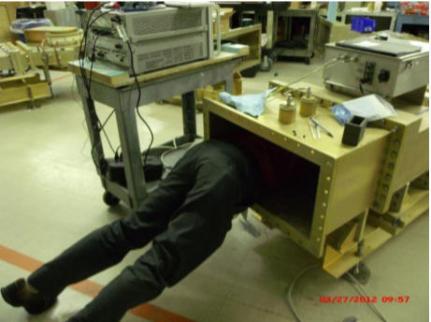
DISADVANTAGES OF WAVEGUIDES(1)
Waveguides have the following disadvantages:
1. Physical size is the primary lower-frequency limitation of waveguides. The width of a waveguide must be approximately a half wavelength at the frequency of the wave to be transported.

Slide 8
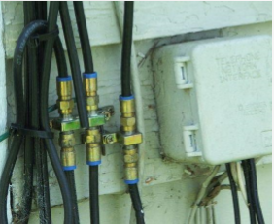
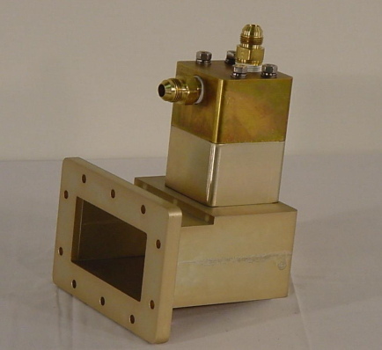
DISADVANTAGES OF WAVEGUIDES(2)
2. Difficult to install: Waveguides are difficult to install because of their rigid, hollow-pipe shape.
Special couplings at the joints are required to assure proper operation.
(a) Coaxial Cable-simple joints
(b) Waveguides-Complex joints

Slide 9
DISADVANTAGES OF WAVEGUIDES(3)
3. High Cost: The inside surfaces of waveguides are often plated with silver or gold to reduce skin effect losses.

Slide 10
DISADVANTAGES OF WAVEGUIDES(4)
4. Dispersive: The wave velocity in a waveguide varies with frequency, causing distortion when signals at different frequencies, such as is in digital communications, are propagating.

Slide 11
COMMON APPLICATION OF WAVEGUIDES
Common applications of waveguides are:
Radar (commercial and military)
Satellite earth stations
CLINAC systems (medical)
Industrial ovens and heating

Slide 12
ALTERNATIVES TO WAVEGUIDES
1. Striplines & Microstrips
Are good at many different frequencies.
Haveto low power levels (~100W)
Applications:
  Cell phones
  Bluetooth devices
  GPS
  RFID tags
  Other small electronics

Slide 13
ALTERNATIVES TO WAVEGUIDES
Co-axial Cables
Good response over wide frequency range
limited to med-low power levels (~1000W)
Common Applications
Cellular Base Stations
TV and radio Transmitters
And a host of low frequency applications

Slide 14
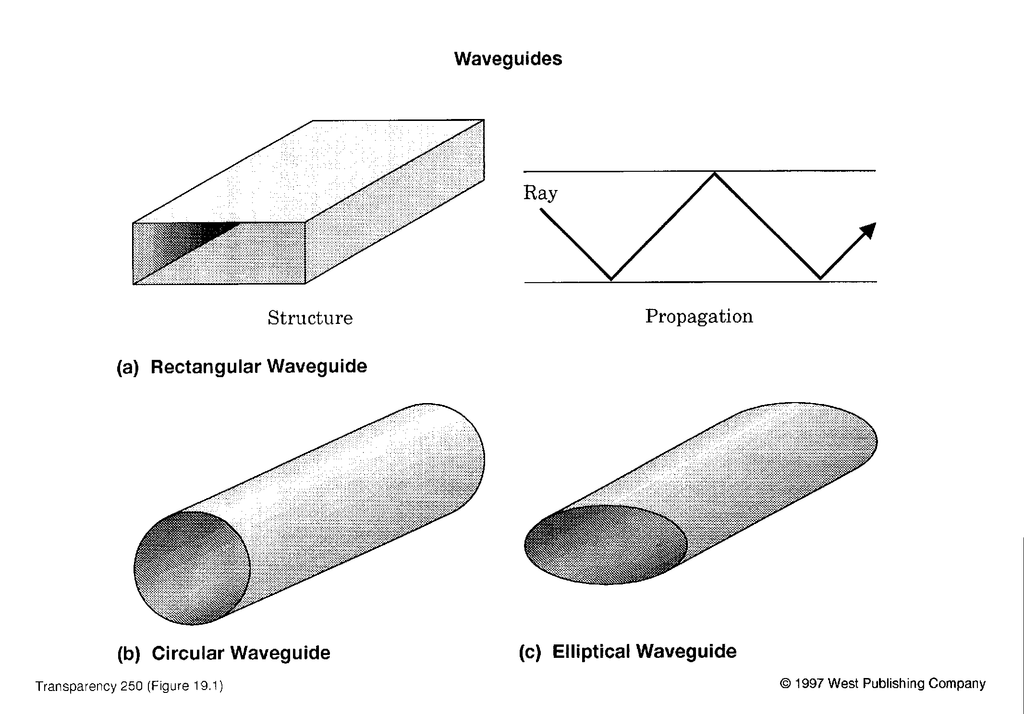
TYPES OF WAVEGUIDES

Slide 15
WAVEGUIDE MODES
Waves can propagate in various ways
Time taken to move down the guide varies with the mode
Each mode has a cutoff frequency below which it won’t propagate
The mode with lowest cutoff frequency is dominant mode

Slide 16
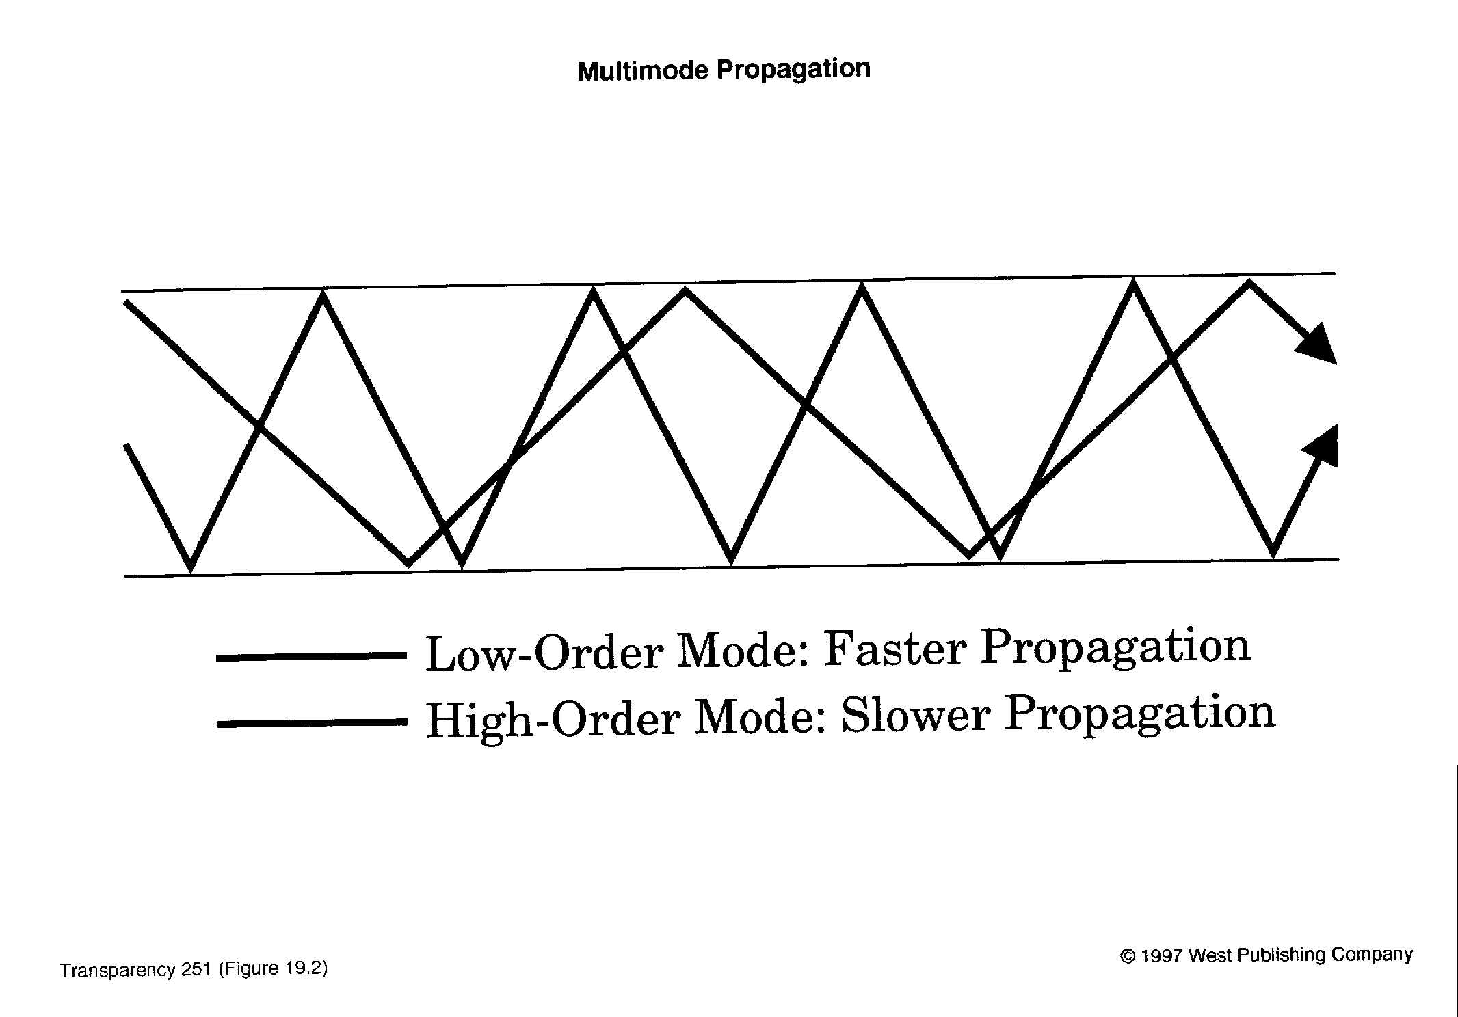
WAVEGUIDE MULTIMODE PROPAGATION

Slide 17
WAVEGUIDE MODE DESIGNATIONS
TE (Transverse Electric)
  Electric field is at right angles to direction of travel
TM (Transverse Magnetic)
  Magnetic field is at right angles to direction of travel
TEM (Transverse Electromagnetic)
  Waves in free space are TEM

Slide 18
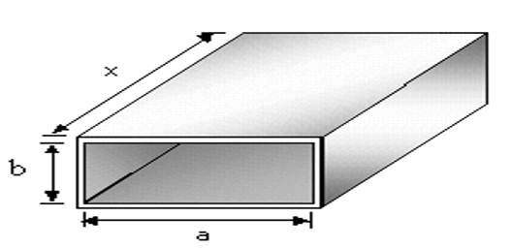
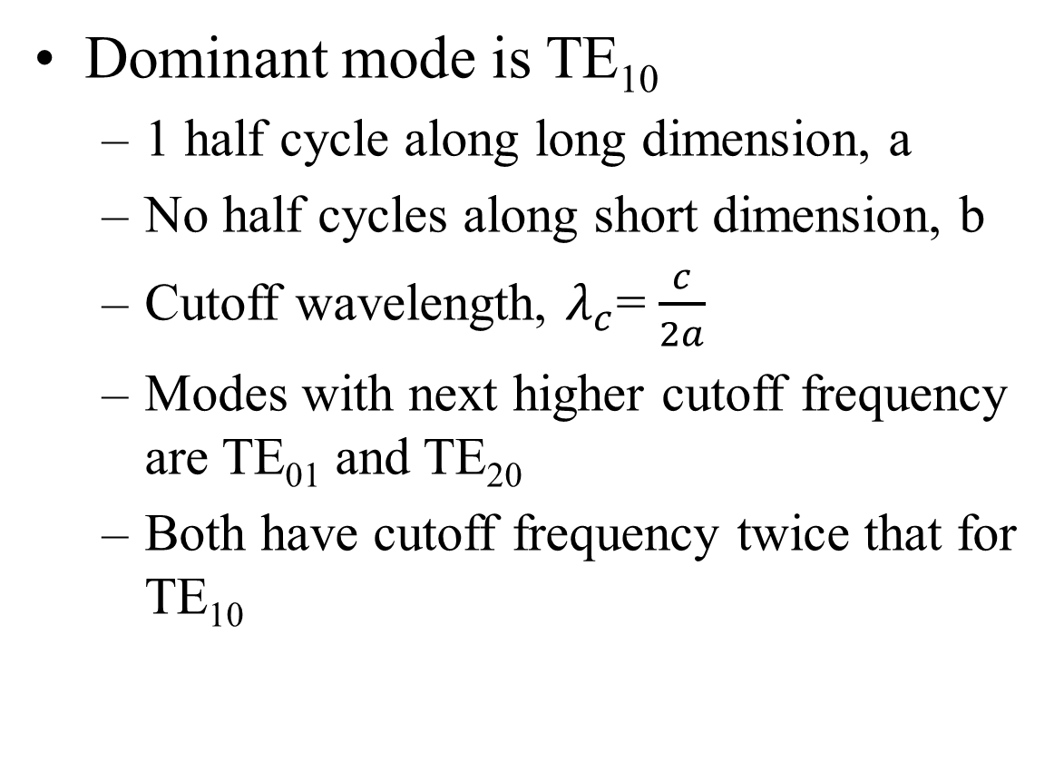
RECTANGULAR WAVEGUIDES
Dominant mode is TE₁₀
  1 half cycle along long dimension, a
  No half cycles along short dimension, b
  Cutoff wavelength, $λ_{c}$= $\frac{c}{2a}$
  Modes with next higher cutoff frequency are TE₀₁ and TE₂₀
  Both have cutoff frequency twice that for TE₁₀

Slide 19
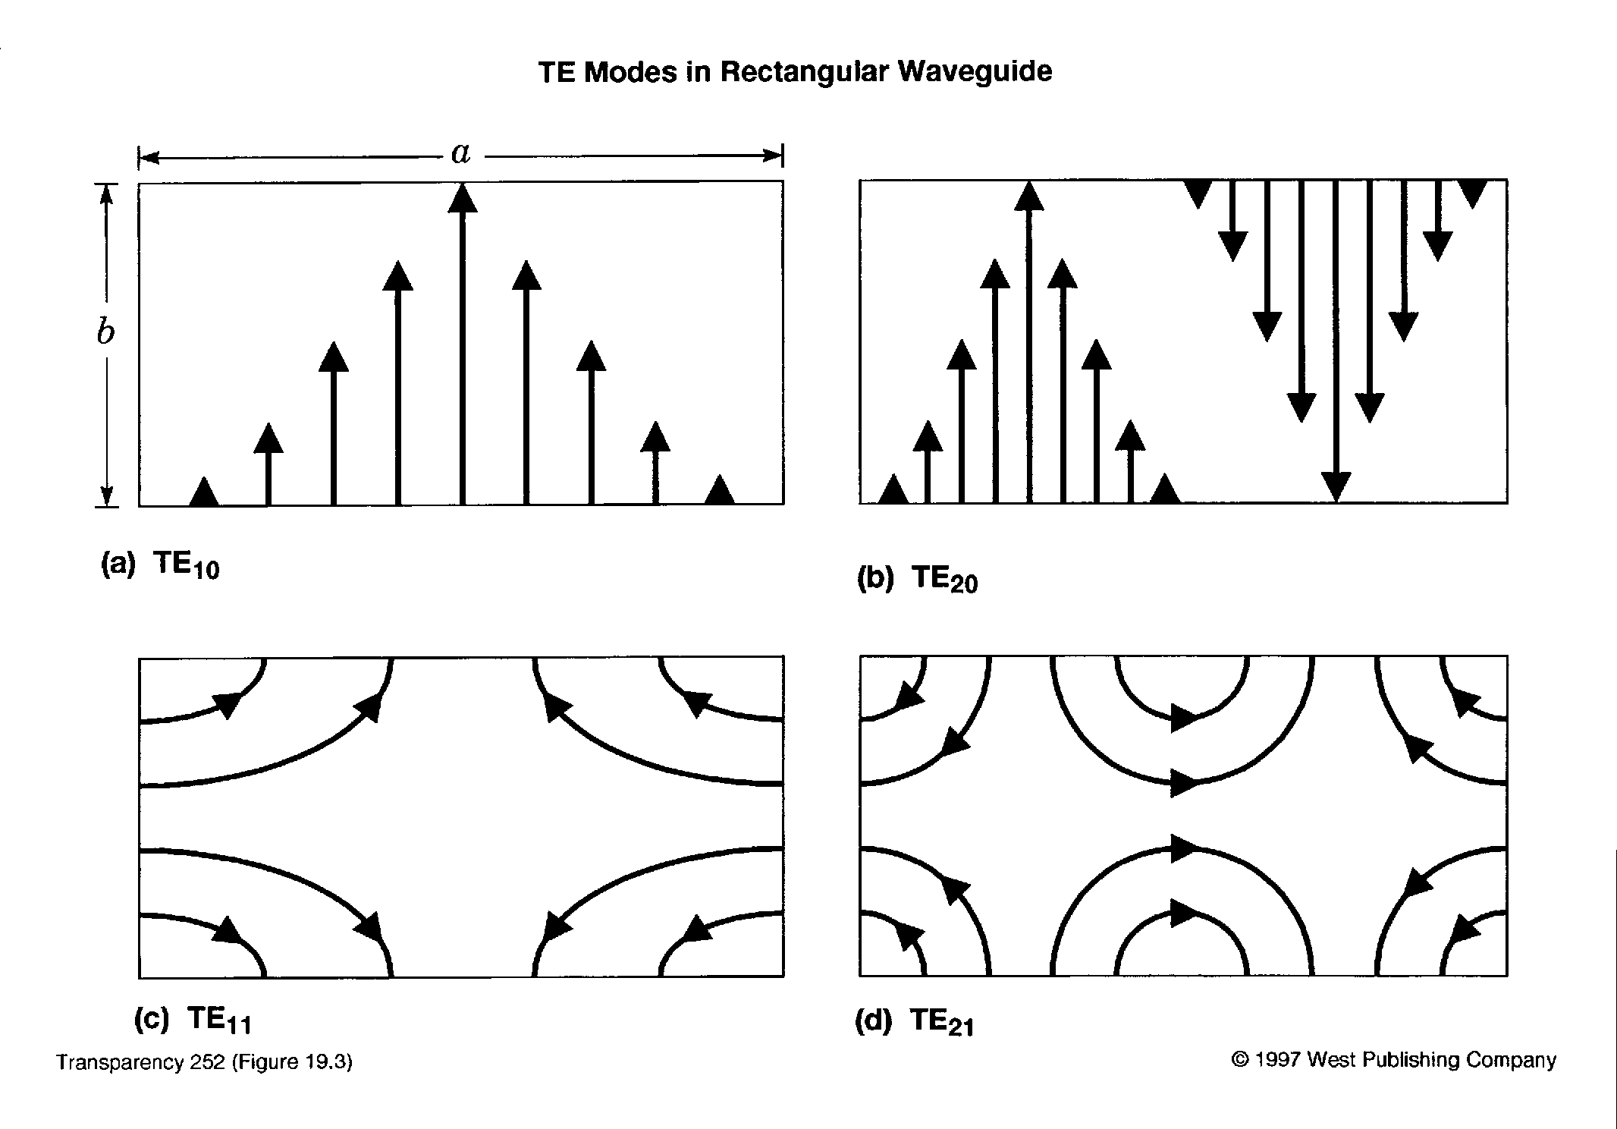





TE MODES IN RECTANGULAR WAVEGUIDES
$$\frac{λ}{2}$$
$$λ$$
$$\frac{λ}{2}$$
$$\frac{λ}{2}$$
$$\frac{λ}{2}$$
$$λ$$

Slide 20
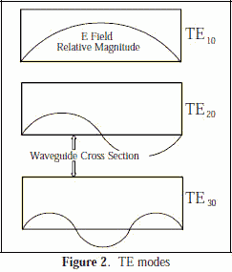
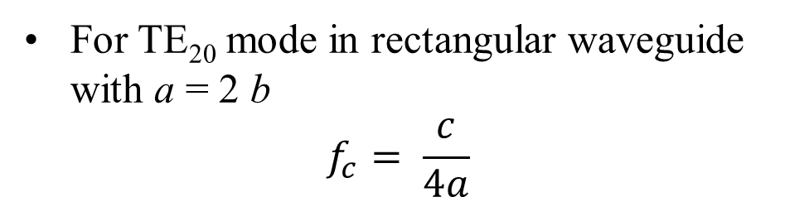
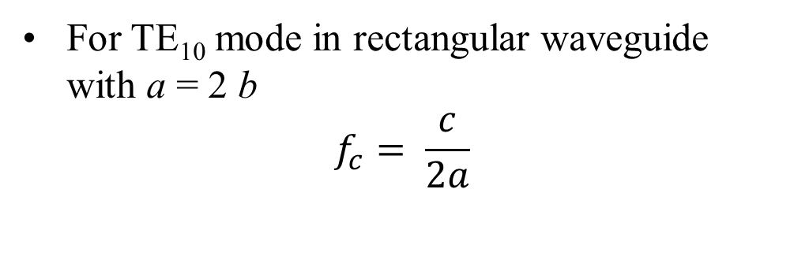
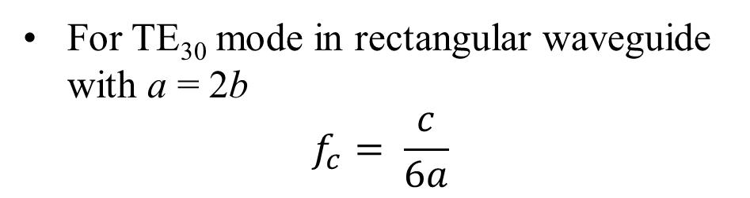
CUTOFF FREQUENCY
TE MODES IN RECTANGULAR WAVEGUIDES
For TE₁₀ mode in rectangular waveguide with a = 2 b
$$f_{c}= \frac{c}{2a}$$
For TE₂₀ mode in rectangular waveguide with a = 2 b
$$f_{c}= \frac{c}{4a}$$
For TE₃₀ mode in rectangular waveguide with a = 2b
$$f_{c}= \frac{c}{6a}$$

Slide 21
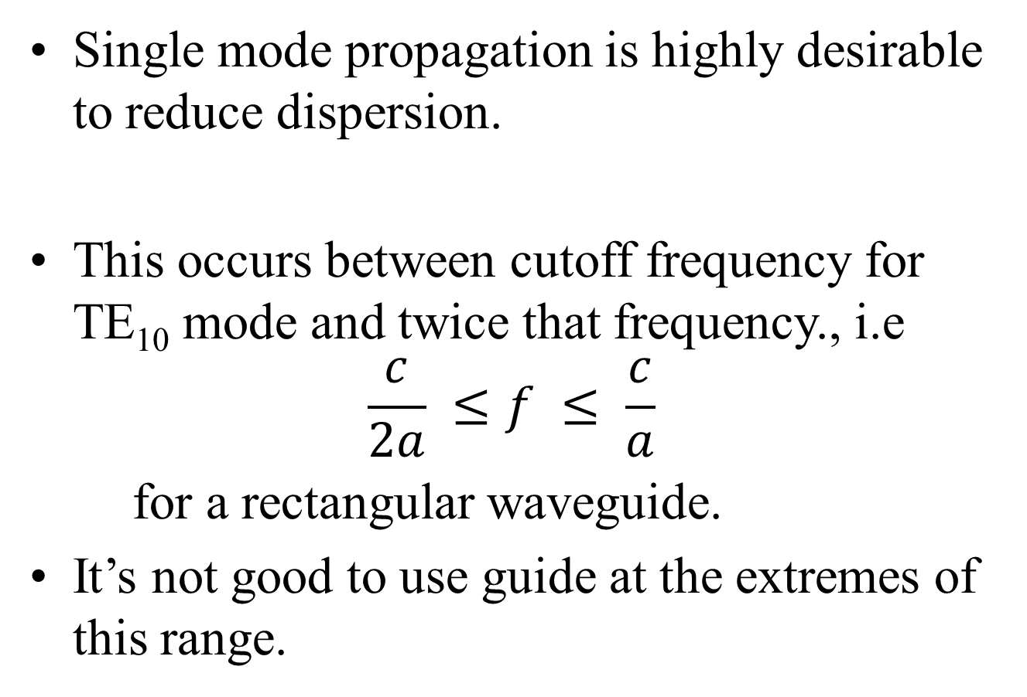
USABLE FREQUENCY RANGE
Single mode propagation is highly desirable to reduce dispersion.
This occurs between cutoff frequency for TE₁₀ mode and twice that frequency., i.e
$$\frac{c}{2a} ≤f ≤ \frac{c}{a}$$
for a rectangular waveguide.
It’s not good to use guide at the extremes of this range.

Slide 22
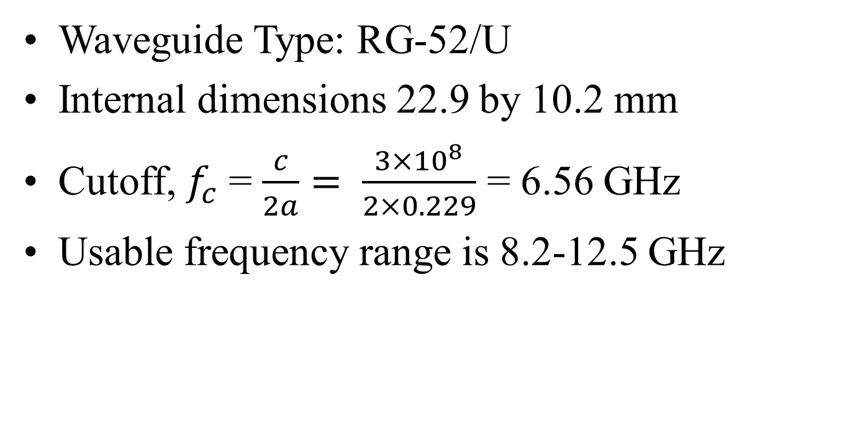
EXAMPLE WAVEGUIDE
Waveguide Type: RG-52/U
Internal dimensions 22.9 by 10.2 mm
Cutoff, $f_{c}$ = $\frac{c}{2a}= \frac{3×{10}^{8}}{2×0.229}$ = 6.56 GHz
Usable frequency range is 8.2-12.5 GHz

Slide 23
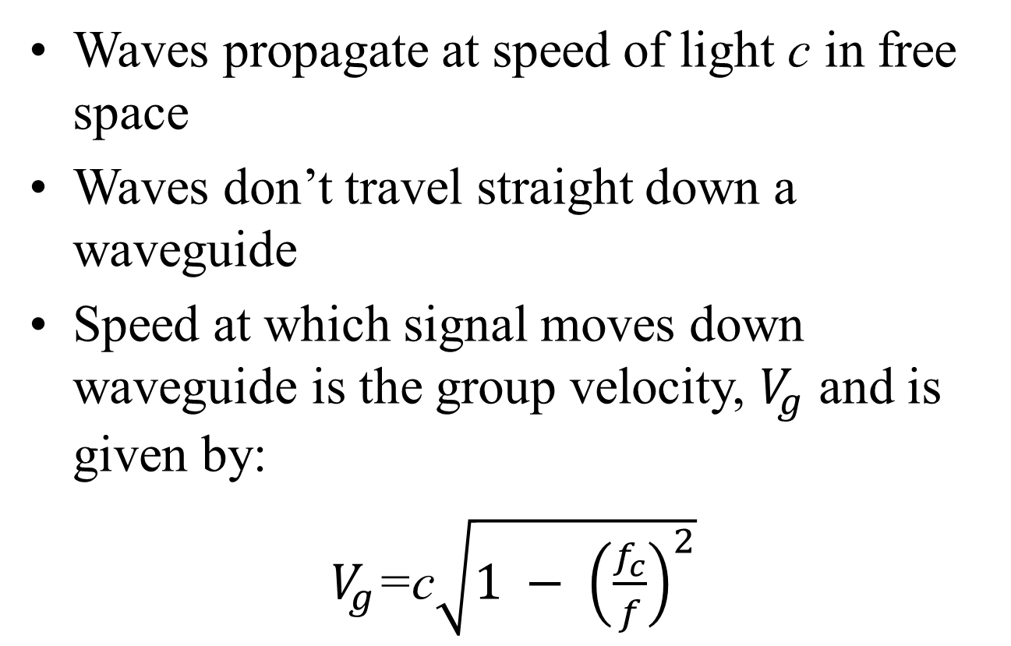
GROUP VELOCITY
Waves propagate at speed of light c in free space
Waves don’t travel straight down a waveguide
Speed at which signal moves down waveguide is the group velocity, $V_{g}$ and is given by:
$V_{g}$=c$\sqrt{1 − {\left(\frac{f_{c}}{f}\right)}^{2}}$

Slide 24
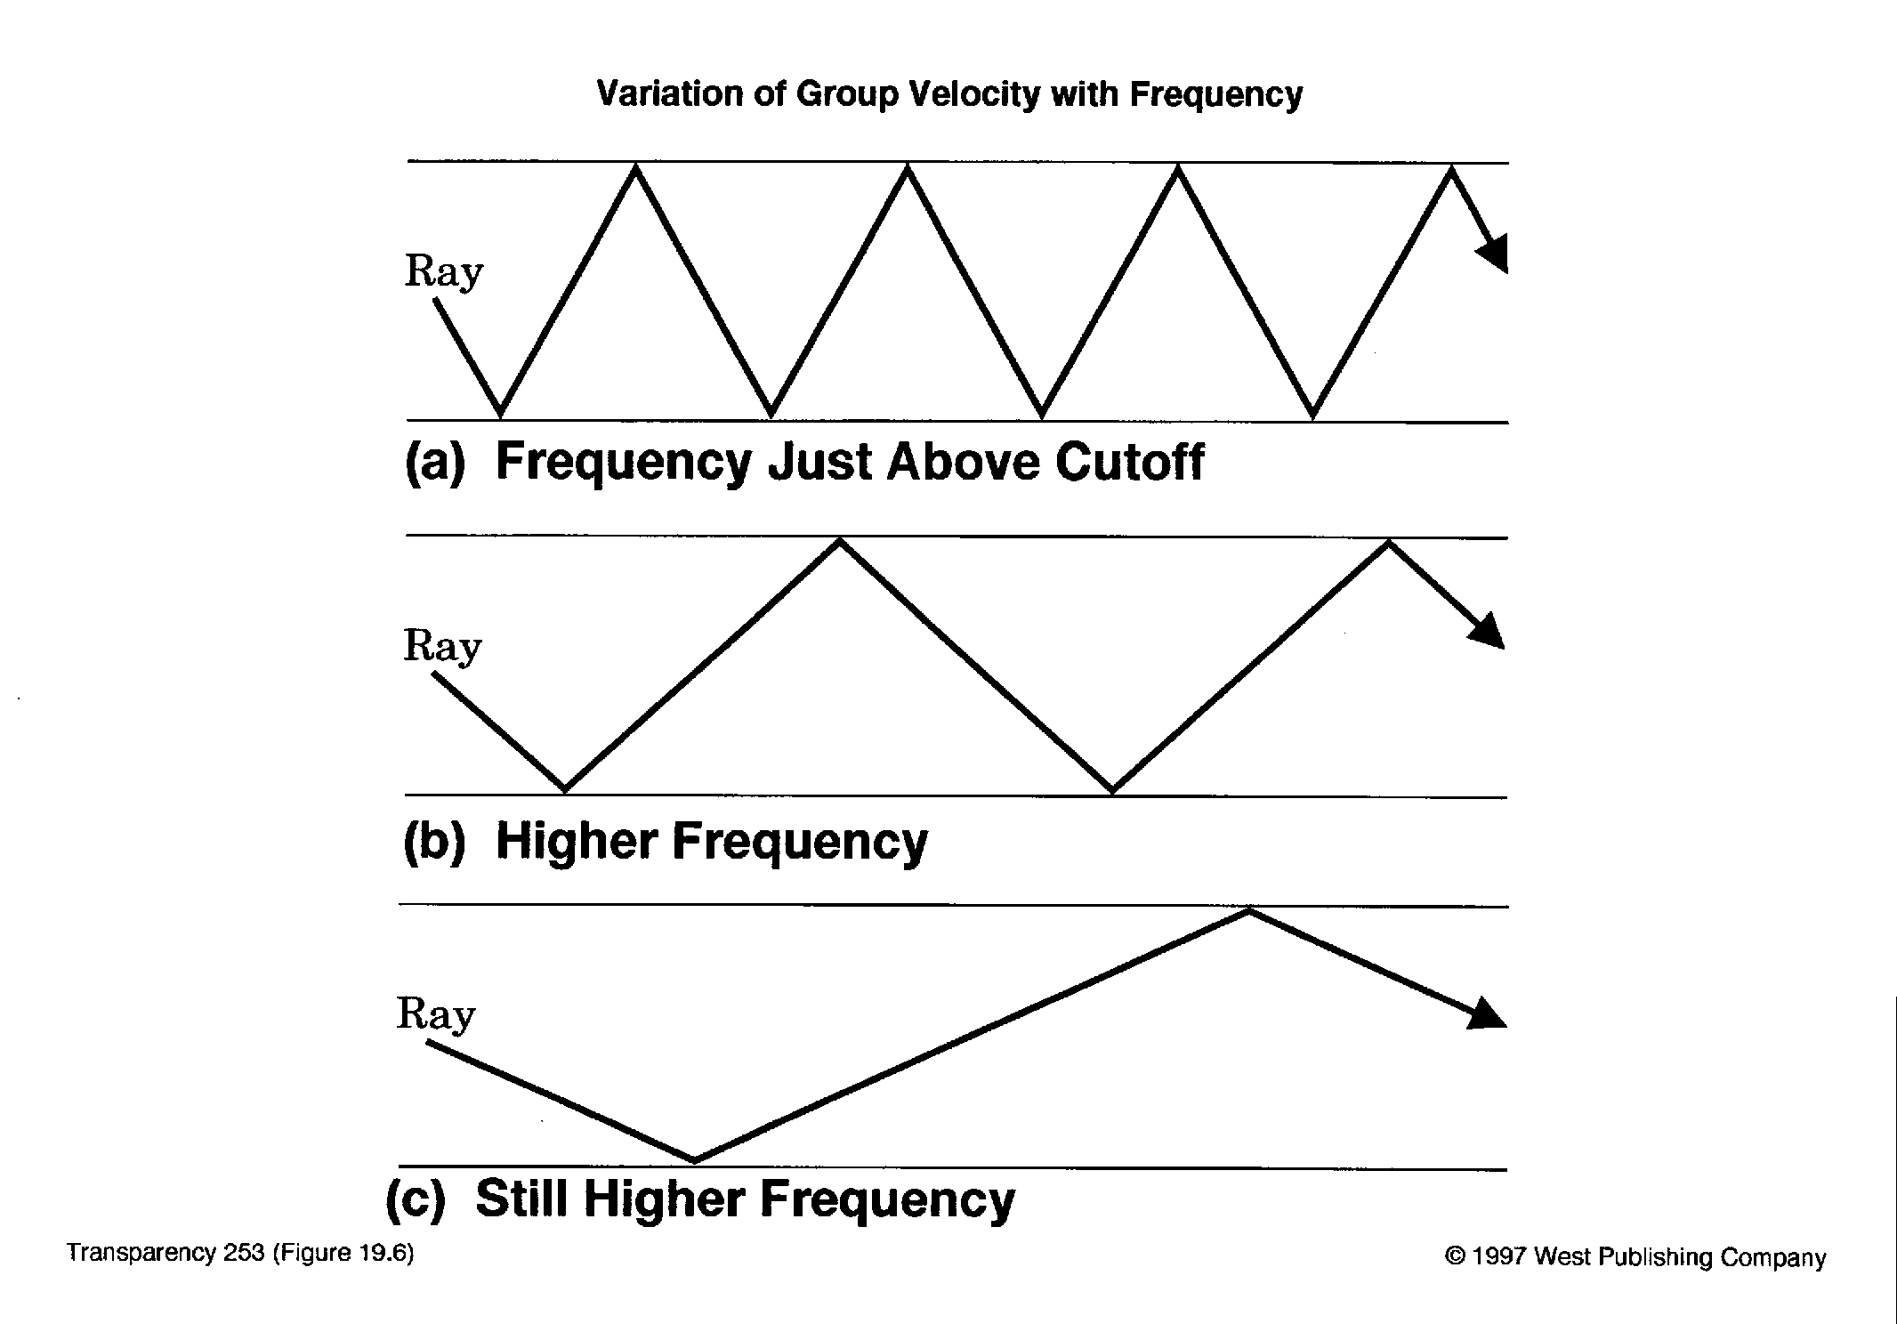
GROUP VELOCITY
Notes:
2003 03 17

Slide 25
PHASE VELOCITY
Phase velocity is the apparent velocity of wave along wall.
Phase velocity is used for calculating wavelength in guide and during impedance matching.

Slide 26
CHARACTERISTIC IMPEDANCE
Characteristic Impedance, Z₀ varies with frequency and is given by

Slide 27
GUIDE WAVELENGTH
Waveguide wavelength is longer than free-space wavelength at same frequency.

Slide 28
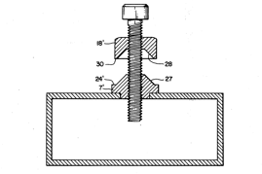
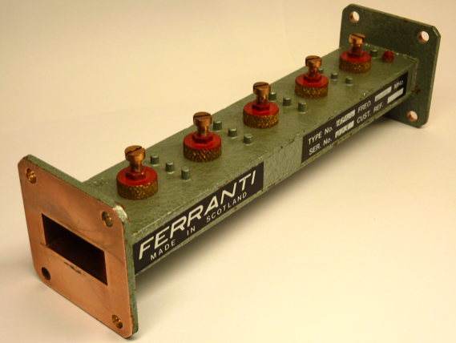
IMPEDANCE MATCHING
Same techniques as for coax can be used
Tuning screws can be used to add capacitance or inductance

Slide 29
COUPLING POWER TO GUIDES
Three common methods of coupling power to waveguides are:
  Probe inserted at a point where E-field is maximum
  Loop inserted at a point where H-field maximum
  Hole inserted at a point where E-field maximum

Slide 30
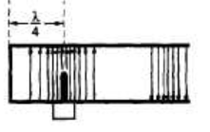
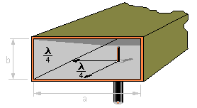
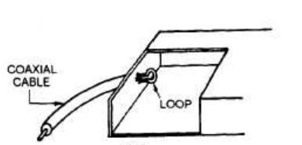
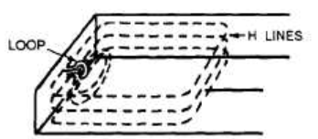
(a) Waveguide probe acts as a quarter-wave antenna. Current flows in the probe and sets up an E field.
(b) Waveguide loop: the loop is inserted at one of several points where the magnetic field will be of greatest strength.

Slide 31
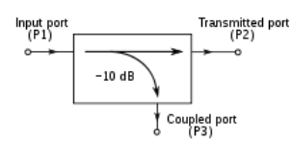
DIRECTIONAL COUPLER
Directional coupler launches or receives power in only 1 direction, i.e port 1 to port 2
Used to split some of power into a second guide, i.e port 3
Can use probes or holes to couple energy to the second guide.

Slide 32
FOUR-PORT DIRECTIONAL COUPLER
Primary
Port 1
Port 2
Four-port
coupler
Port 3
Port 4
Secondary

Slide 33
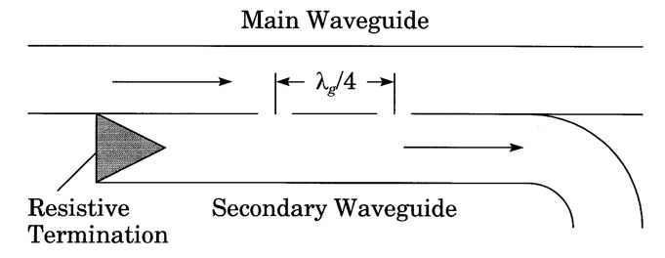
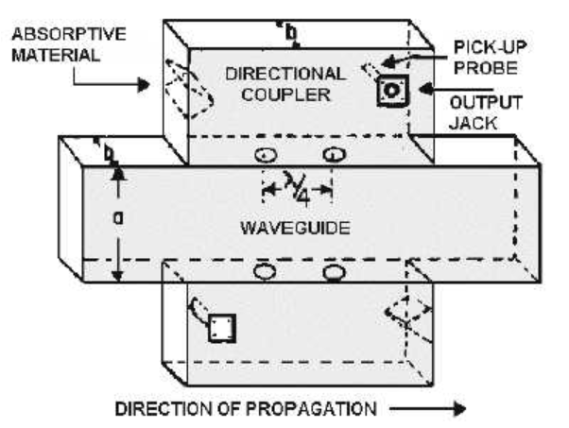
TWO-HOLE DIRECTIONAL COUPLER
Notes:
2003 03 18

Slide 34
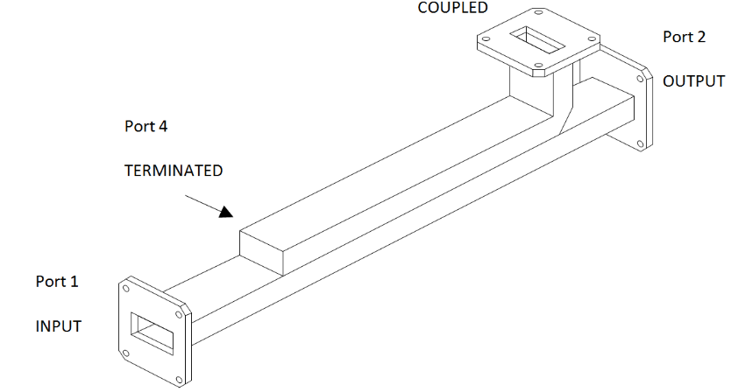
MULTI-HOLE DIRECTIONAL COUPLERS(1)
Multi-hole directional couplers are assumed as four-port (Input, Output, Sampling/Coupled and Isolated/Terminated), devices which consisted of two transmission lines that are electromagnetically coupled to each other using more than two holes.

Slide 35
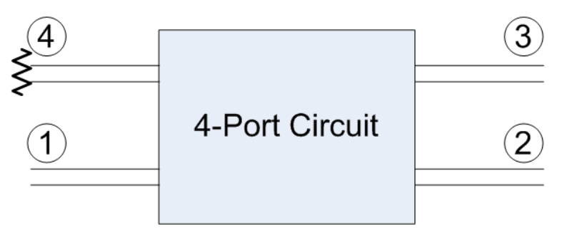
MULTI-HOLE DIRECTIONAL COUPLERS (2)
4. Isolated/Terminated
is internally is matched to damp the residual internally reflected waves from port 2 and port 3.
3. Coupled/Sampling
The rest of the input signal appears here.
1. Input Port
Input Signal is applied here
Output Port
Part of input signal

Slide 36
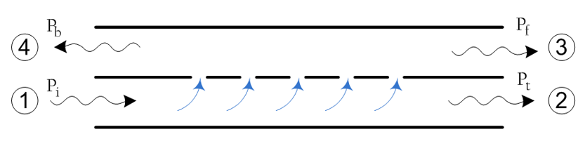
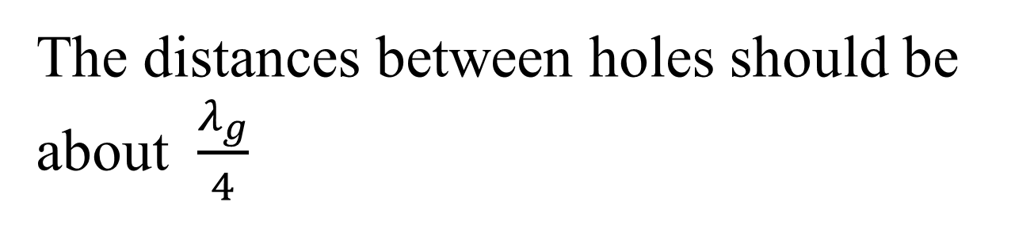
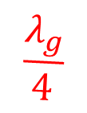
MULTI-HOLE DIRECTIONAL COUPLERS (3)
The distances between holes should be about $\frac{λ_{g}}{4}$
$$\frac{λ_{g}}{4}$$

Slide 37
OTHER PASSIVE MICROWAVE COMPONENTS
Other passive microwave components include:
Bends
  Called E-plane or H-Plane bends depending on the direction of bending
Tees
  Also have E and H-plane varieties
  Hybrid or magic tee combines both and can be used for isolation

Slide 38
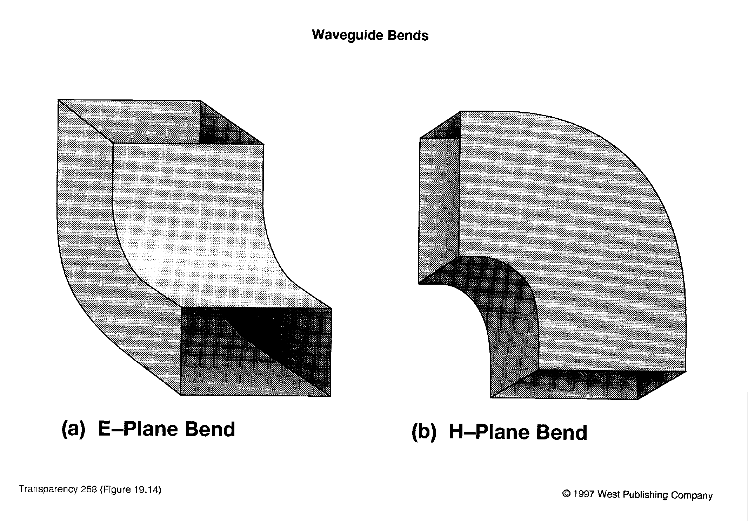
WAVEGUIDE BENDS

Slide 39
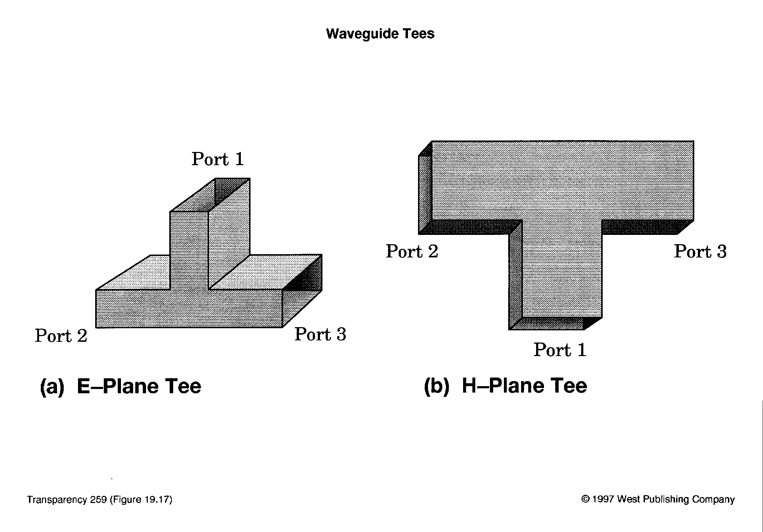
WAVEGUIDE TEES

Slide 40
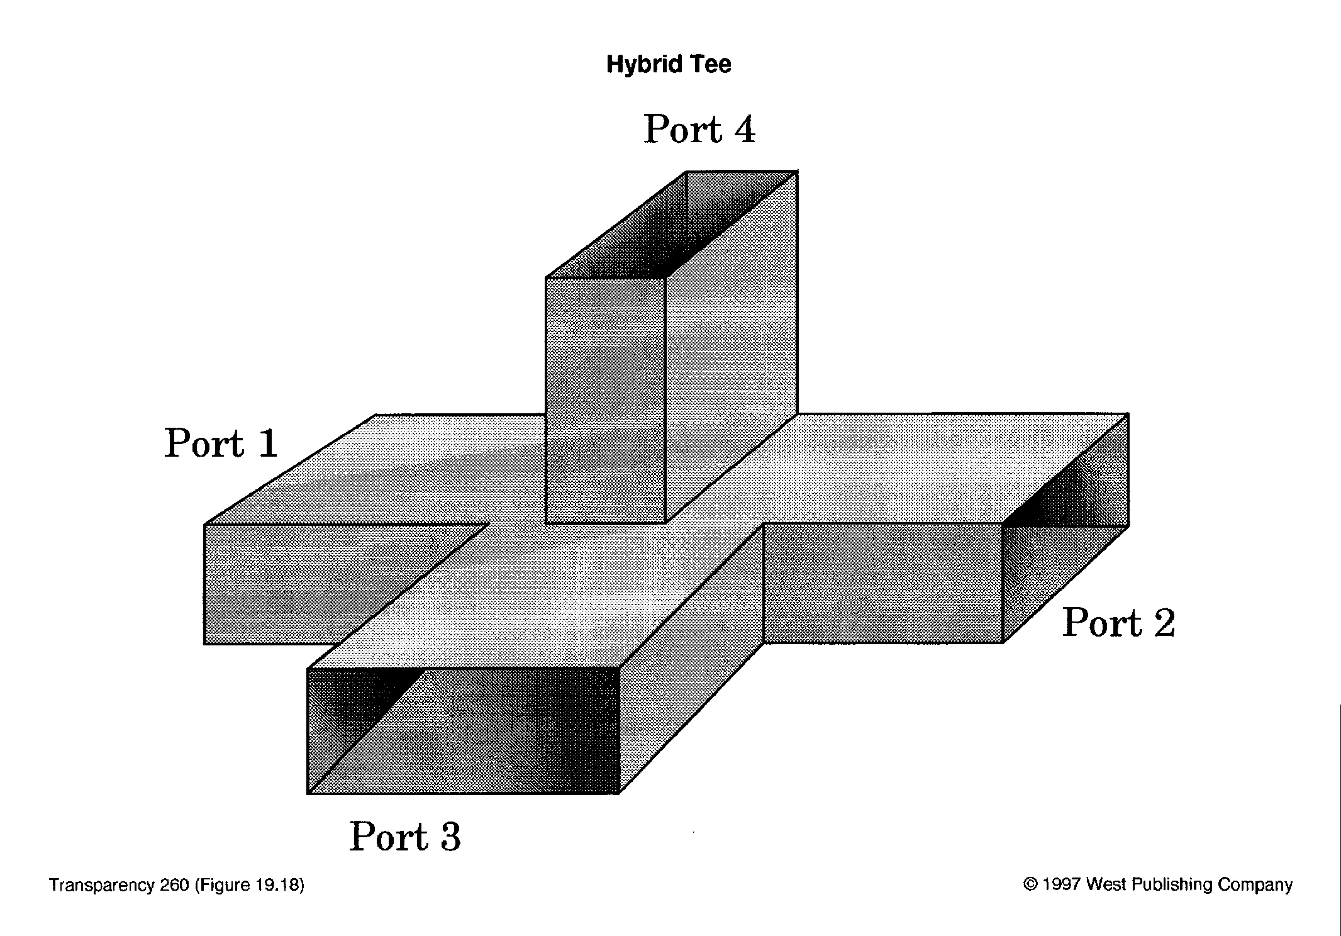
MICROWAVE HYBRID TEE

Slide 41
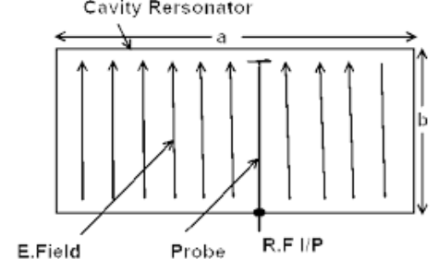
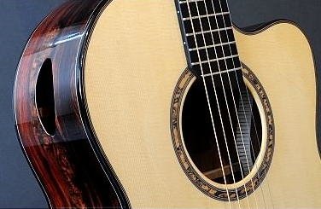
RESONANT CAVITY
A microwave cavity consists of a closed (or largely closed) metal structure that confines electromagnetic fields.
The structure is either hollow or filled with dielectric material.
At the cavity's resonant frequencies the waves reinforce to form standing waves in the cavity.
The cavity functions like an organ pipe or sound box in a musical instrument.

Slide 42
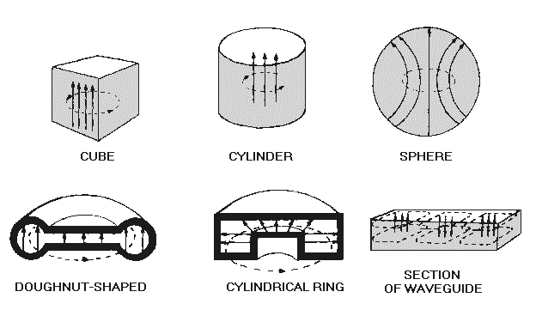
TYPES OF MICROWAVE CAVITIES
Microwave cavities can be cubes, cylinders, spheres or a combination.

Slide 43
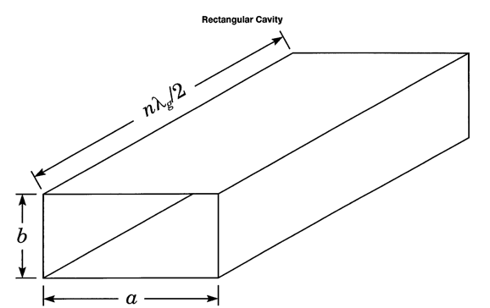
RECTANGULAR RESONANT CAVITY

Slide 44
ATTENUATORS AND LOADS
Attenuator works by putting carbon vane or flap into the waveguide
Currents induced in the carbon cause loss
Load is similar but at end of guide

Slide 45
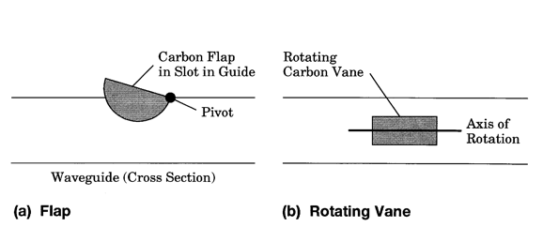
MICROWAVE ATTENUATORS
Microwave attenuators are passive devices which control power levels in microwave system by absorption of the signal. They may be fixed or variable.
Fixed attenuators are used to lower the amplitude balance to enable measurements, or to protect the measuring device from signal levels that could be damaging.
Variable attenuations may be operated with a multi-turn screwdriver-slotted shaft, turns counting dial, knob control dial option

Slide 46
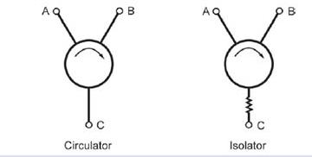
CIRCULATOR AND ISOLATOR
Circulators and isolators use the unique properties of ferrites in a magnetic field.
Isolator passes signals in one direction, attenuates in the other.
Circulator passes input from each port to the next around the circle, not to any other port.

Slide 47
A microwave circulator is a multiport waveguide junction in which the wave can flow only from the nth port to the (n + 1)th port in one direction. The four-port microwave circulator is the most common.
Port 4
Port 2
Port 3
Port 2

Slide 48
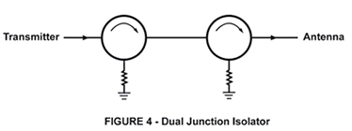
EXAMPLE APPLICATION OF ISOLATOR

Slide 49
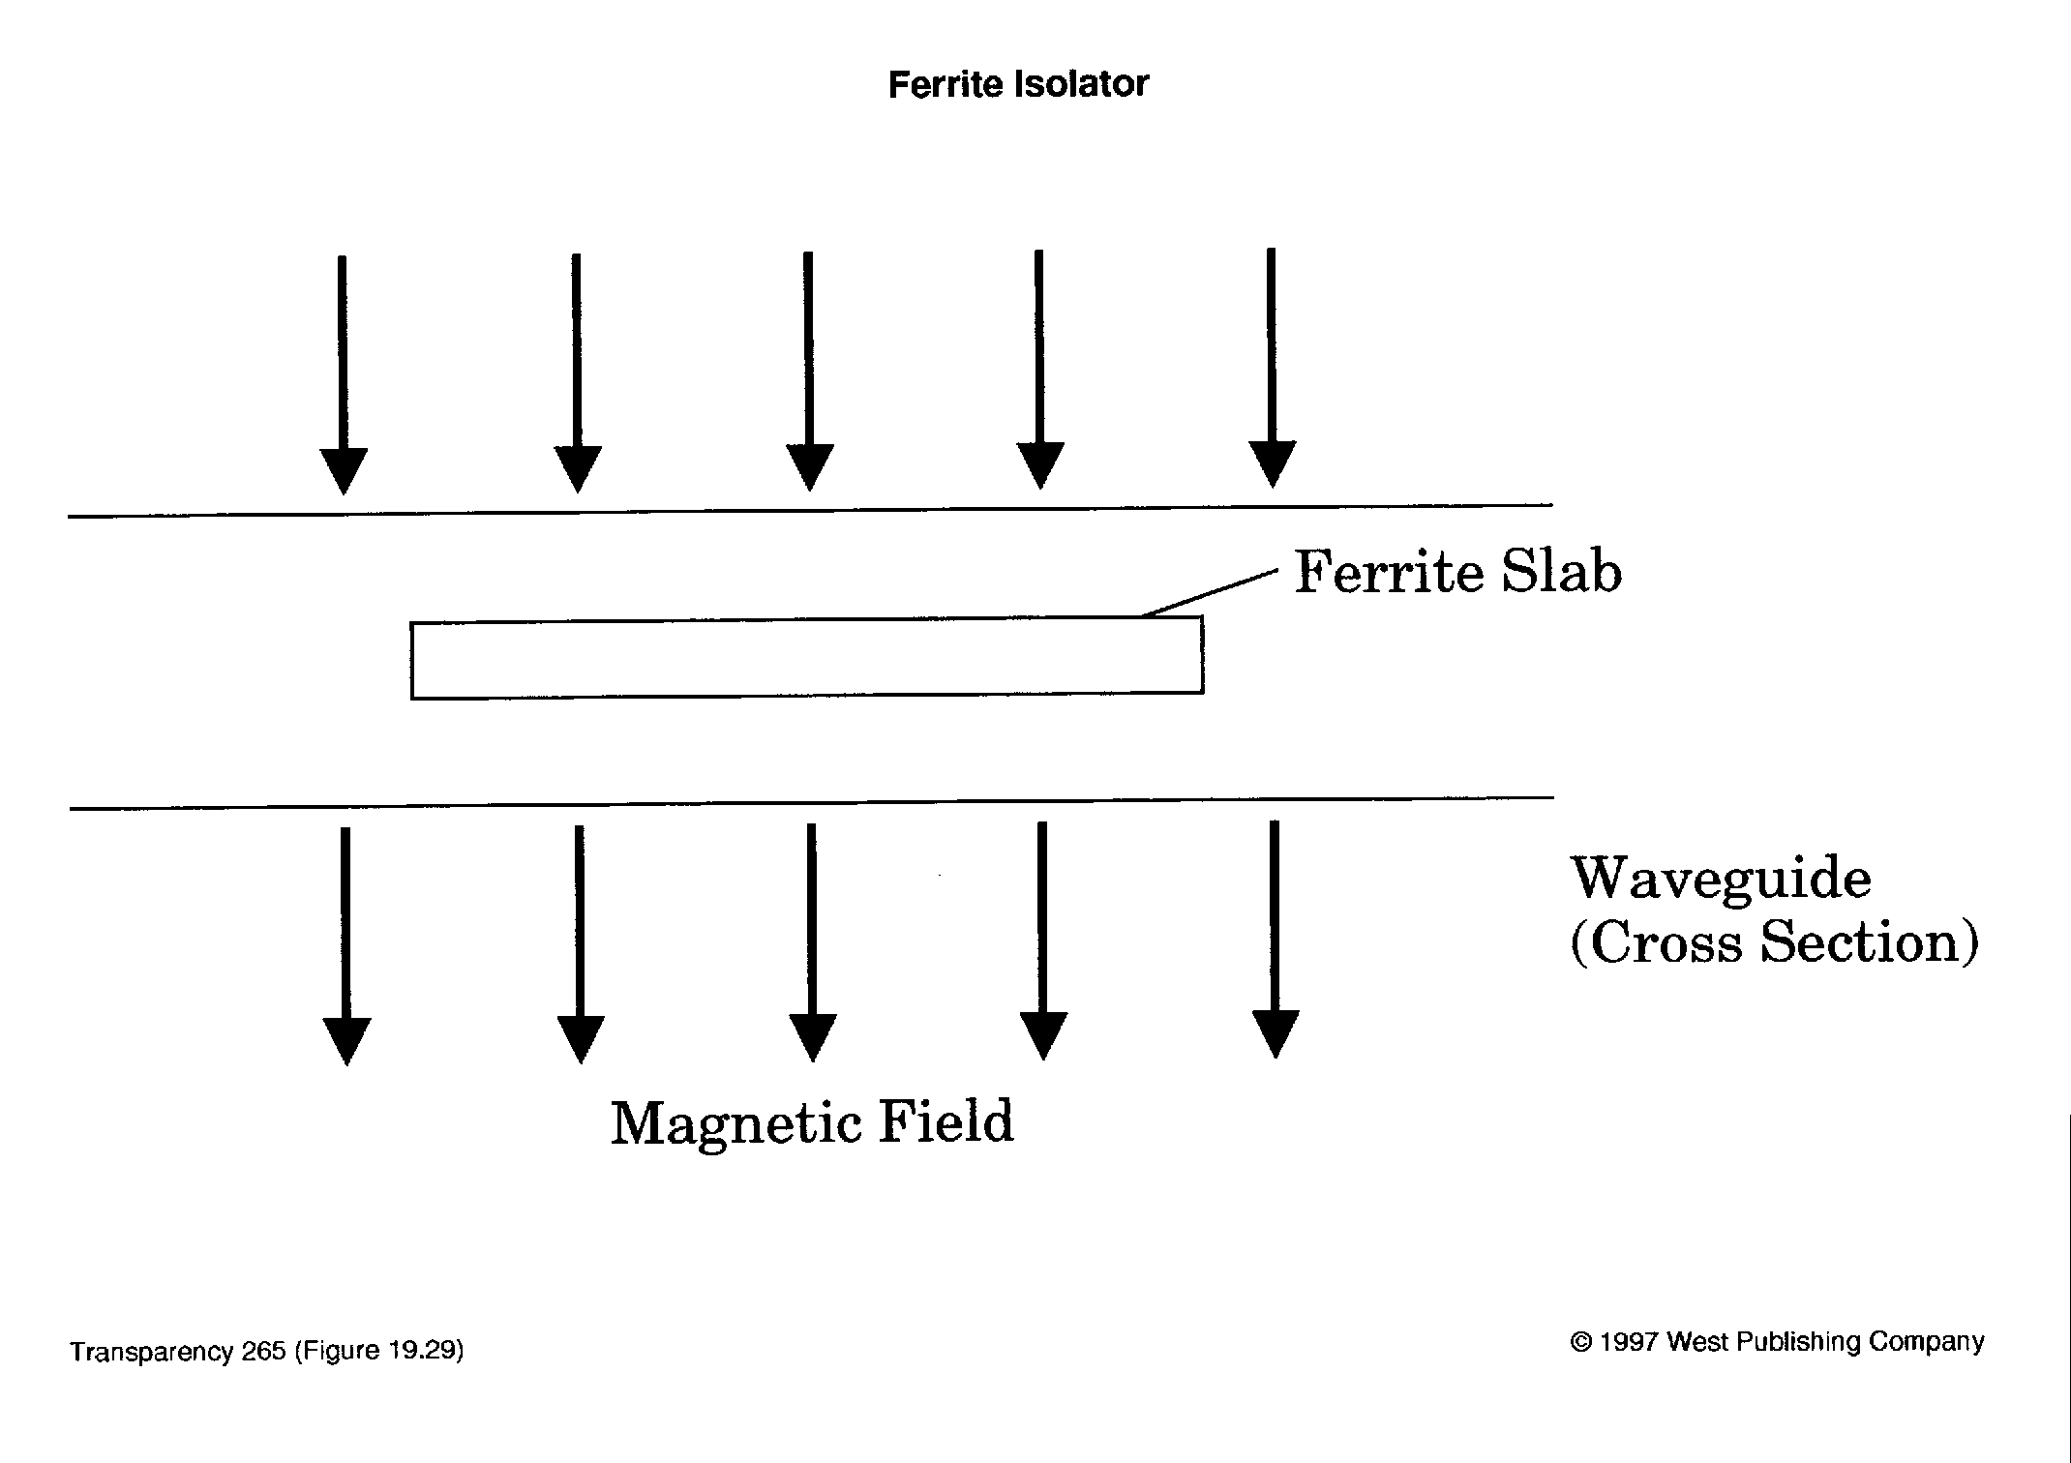
FERRITE ISOLATOR

Slide 50
MICROWAVE SOLID-STATE DEVICES
Notes:
2003 03 20

Slide 51
TYPES OF MICROWAVE TRANSISTORS
  MESFETs (Metal-Semiconductor FETs)
  HEMTs (High Electron Mobility Transistors)
  MOSFETs
  BJTs
  HBTs (Heterojunction Bipolar Transistors)

Slide 52
APPLICATIONS
Microwave transistors are used in
Low Noise Amplifiers (LNA)
Power Amplifiers,
Mixers,
Frequency converters and multipliers
Attenuators,
Phase shifters
They can be into 2 groups:
  low-noise transistors and
  power transistors

Slide 53
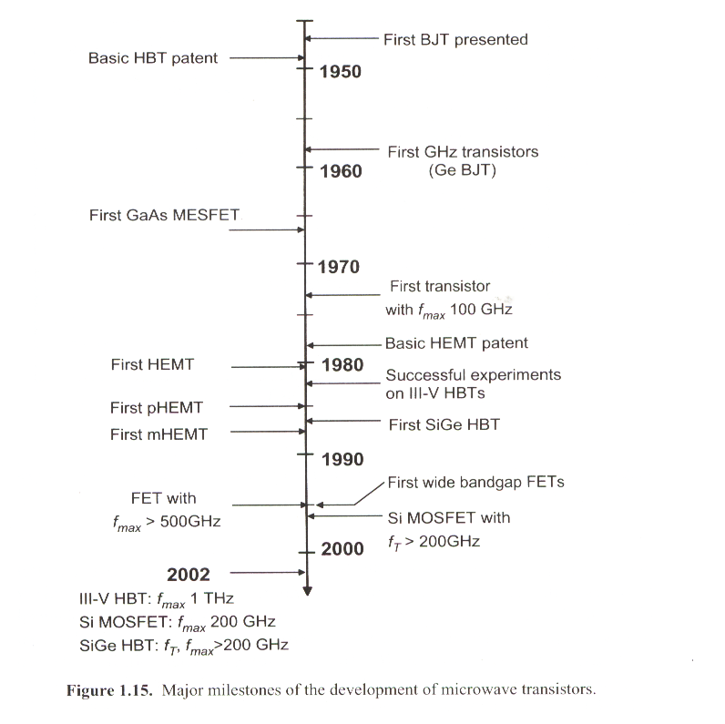

Slide 54
MICROWAVE TRANSISTORS (2)
Microwave transistors are designed to minimize capacitances and transit time
NPN bipolar and N channel FETs preferred because free electrons move faster than holes
Gallium Arsenide has greater electron mobility than silicon

Slide 55
GUNN DEVICE (1)
Slab of N-type GaAs (gallium arsenide).
Sometimes called Gunn diode but has no junctions.
Has a negative-resistance region where drift velocity decreases with increased voltage which causes a concentration of free electrons called a domain.

Slide 56
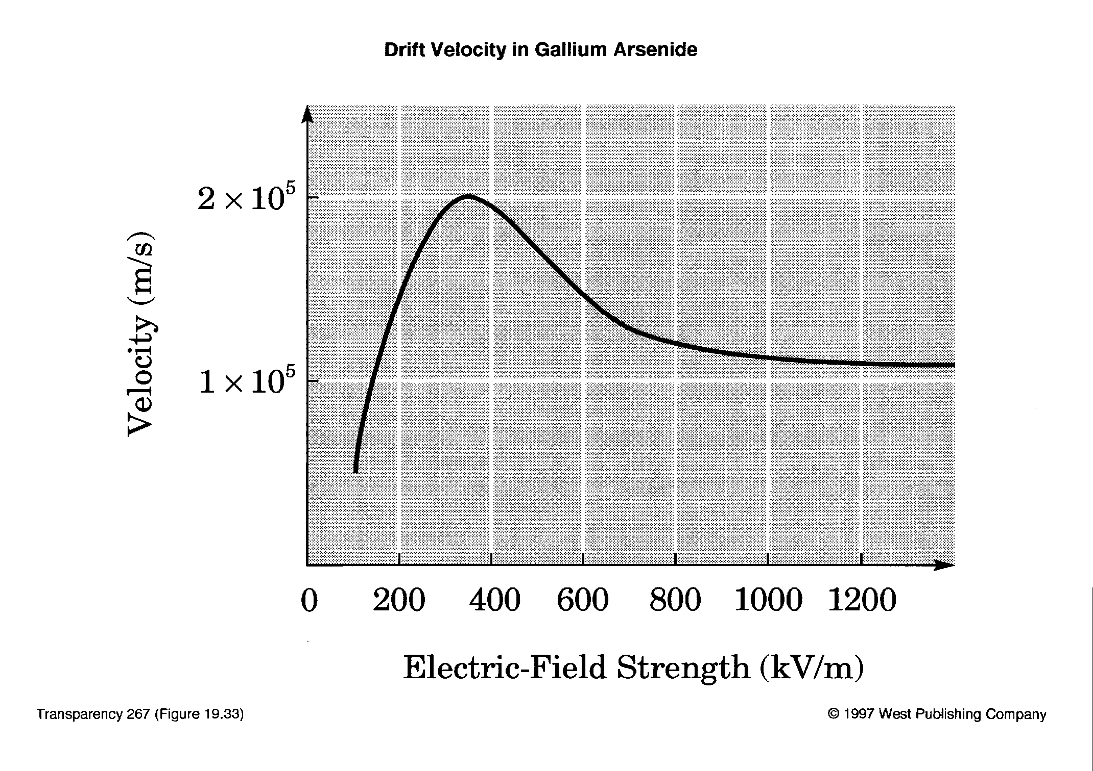
GUNN DEVICE (2)
Notes:
2003 03 24

Slide 57
TRANSIT-TIME MODE
Domains move through the GaAs till they reach the positive terminal
When domain reaches positive terminal it disappears and a new domain forms
Pulse of current flows when domain disappears
Period of pulses = transit time in device

Slide 58
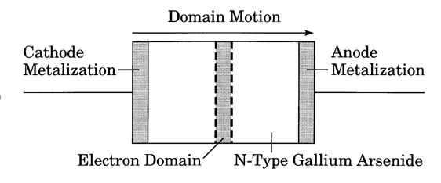
GUNN DEVICE (3)

Slide 59

GUNN OSCILLATOR FREQUENCY
$T= \frac{d}{v}$
  T = period of oscillation
  d = thickness of device
  $v$= drift velocity, about 1 × 10⁵ m/s
f = 1/T

Slide 60
IMPATT DIODE (1)
IMPATT stands for Impact Avalanche And Transit Time
Operates in reverse-breakdown (avalanche) region
Applied voltage causes momentary breakdown once per cycle
This starts a pulse of current moving through the device
Frequency depends on device thickness

Slide 61
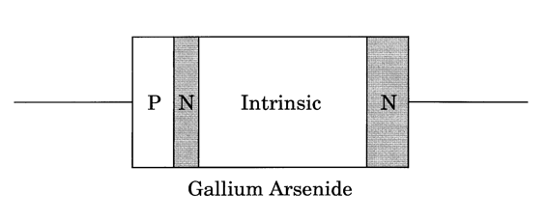
IMPATT DIODE (2)

Slide 62
PIN DIODE (1)
P-type --- Intrinsic --- N-type
Used as switch and attenuator
Reverse biased - off
Forward biased - partly on to on depending on the bias

Slide 63
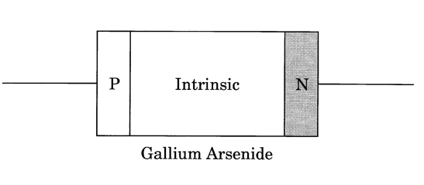
PIN DIODE (2)
A PIN diode has a wide, un-doped intrinsic semiconductor region between a p-type semiconductor and an n-type semiconductor region.
The p-type and n-type regions are typically heavily doped.
The PIN diode is widely used in attenuators, fast switches, photodetectors, and high voltage power electronics applications.

Slide 64
VARACTOR DIODE
Varactor diode is used at lower frequencies as voltage-variable capacitor
At microwaves, it is used as frequency multiplier
  this takes advantage of the nonlinear V-I curve of diodes

Slide 65
YIG DEVICES
YIG stands for Yttrium - Iron - Garnet
  YIG is a ferrite
YIG sphere in a dc magnetic field is used as resonant cavity
Changing the magnetic field strength changes the resonant frequency

Slide 66
MICROWAVE TUBES
Used for high power/high frequency applications
Tubes generate and amplify high levels of microwave power more cheaply than solid state devices
Conventional tubes can be modified for low capacitance but specialized microwave tubes are also used

Slide 67
MAGNETRON
High-power oscillator
Common in radar and microwave ovens
Cathode in center, anode around outside
Strong dc magnetic field around tube causes electrons from cathode to spiral as they move toward anode
Current of electrons generates microwaves in cavities around outside

Slide 68
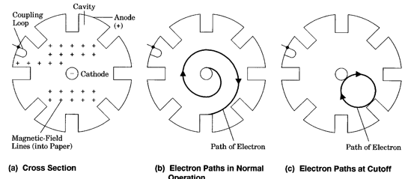
CAVITY MAGNETRON
Magnetron has cavities all around the outside
Wave circulates from one cavity to the next around the outside
Each cavity represents one-half period
Wave moves around tube at a velocity much less than that of light
Wave velocity approximately equals electron velocity

Slide 69
CROSSED-FIELD AND LINEAR-BEAM TUBES
Magnetron is one of a number of crossed-field tubes
  Magnetic and electric fields are at right angles
Klystrons and Traveling-Wave tubes are examples of linear-beam tubes
  These have a focused electron beam (as in a CRT)

Slide 70
KLYSTRON (1)
Used in high-power amplifiers
Electron beam moves down tube past several cavities.
Input cavity is the buncher, output cavity is the catcher.
Buncher modulates the velocity of the electron beam

Slide 71
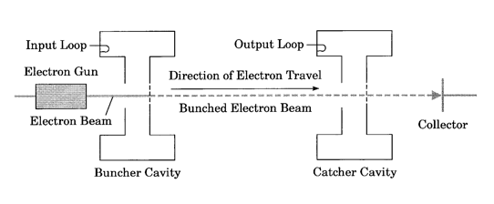
KLYSTRON (2)

Slide 72
VELOCITY MODULATION
Electric field from microwaves at buncher alternately speeds and slows electron beam.
This causes electrons to bunch up.
Electron bunches at catcher induce microwaves with more energy.
The cavities form a slow-wave structure.

Slide 73

APPLEGATE DIAGRAM
Applegate diagram shows electron paths in the velocity-modulated tube

Slide 74
TRAVELING-WAVE TUBE (1)
Uses a helix as a slow-wave structure
Microwaves input at cathode end of helix, output at anode end
Energy is transferred from electron beam to microwaves

Slide 75

TRAVELING-WAVE TUBE (2)

